Slide 1
假定你是学生会主席李华，学生会将面向交换生举行“China in my eyes”微电影作品展。请你根据提示写一则通知，主要内容包括:
1.活动介绍; 2.截止时间; 3.欢迎报名参加。
注意:
1. 写作词数应为80左右;
2. 请按如下格式在答题卡的相应位置作答
参考词汇: 微电影microfilm

Slide 2
To enrich our school life, the Students' union is to hold a Microfilm Exhibition Show for exchange students in our school.
Themed "China in my eyes", the activity is meant to show your discovery of a wonderful China. Any foreign student interested in and skilled at video-making is welcome to sign up for it. The microfilm is expected to be a 15-minute one and should be submitted by July 1 It's really a good chance for you to show your talent for shooting a film. Come on!
Students' union
06.02.2021

Slide 3
?
To enrich our school life, the Students' union is to hold a Microfilm Exhibition Show for exchange students in our school.
Themed "China in my eyes", the activity is meant to show your discovery of a wonderful China. Any foreign student interested in and skilled at video-making is welcome to sign up for it. The microfilm is expected to be a 15-minute one and should be submitted by July 1. It's really a good chance for you to show your talent for shooting a film.
Come on!
Students' union
06.02.2021

Slide 4
Notice
To enrich school life, the Students' union is to hold a Microfilm Exhibition Show for exchange students in the school.
Themed "China in my eyes", the activity is meant to show your discovery of a wonderful China. Whatever you find impressive is welcome. The microfilm you shoot is expected to be within 15 minutes and should be submitted before July 1 to the school website. Any foreign student interested in and skilled at video-making is welcome to sign up for it to show your talent and share with us what China is like in your eyes.
Don't hesitate to show your “China” now!/
Anticipating your participation!
Students' union
06.02.2021

Slide 5
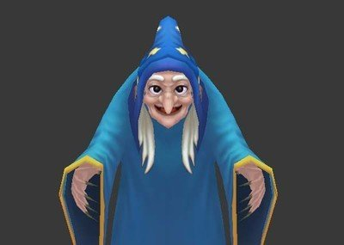
2021年5月金丽衢十二校读后续写讲评
The Christmas Witch

Slide 6
Read for detailed information
Every kid in my neighborhood knew about the Christmas Witch. She was an elderly woman who left her Christmas decorations up all year long: a twinkling tree in the living room, a plastic wreath（花环）on the front door, and...
I was told the decorations were meant to get kids closer to the house so the Christmas Witch could take them. I promised myself I would never go near that place. But when I turned fourteen, I got a newspaper route and discovered I'd have to deliver papers to the Christmas Witch. But my mother just advised me not to worry.
Every kid in my neighborhood knew about the Christmas Witch. She was an elderly woman who left her Christmas decorations up all year long: a twinkling tree in the living room, a plastic wreath（花环）on the front door, and...
I was told the decorations were meant to get kids closer to the house so the Christmas Witch could take them. I promised myself I would never go near that place. But when I turned fourteen, I got a newspaper route and discovered I'd have to deliver papers to the Christmas Witch. But my mother just advised me not to worry.
Every kid in my neighborhood knew about the Christmas Witch. She was an elderly woman who left her Christmas decorations up all year long: a twinkling tree in the living room, a plastic wreath（花环）on the front door, and...
I was told the decorations were meant to get kids closer to the house so the Christmas Witch could take them. I promised myself I would never go near that place. But when I turned fourteen, I got a newspaper route and discovered I'd have to deliver papers to the Christmas Witch. But my mother just advised me not to worry.
Who was the Christmas Witch?
What’s my attitude to her?
What about my mother's?
I promised never to go near the house of the Christmas Witch but I had to because it's right on my route.

Slide 7
Read for detailed information
以景烘情
My first day of delivery was a dark, freezing March morning. The sky was just turning pink as I approached the last house on my route… that of the Christmas Witch. I tiptoed up the porch steps and placed the newspaper by the door. Then I quickly turned around. And just then I slipped, and fell down the stairs. I sprained my ankle, unable to walk.
My first day of delivery was a dark, freezing March morning.
My first day of delivery was a dark, freezing March morning. The sky was just turning pink as I approached the last house on my route… that of the Christmas Witch. I tiptoed up the porch steps and placed the newspaper by the door. Then I quickly turned around. And just then I slipped, and fell down the stairs. I sprained my ankle, unable to walk.
动作描写
What can we infer from it about the author's feeling?
reluctant/ upset...
What can you infer from the verbs “tiptoed up” “quickly turned around”?
The author wanted to flee the house quickly;
The author didn’t want to meet the CW.

Slide 8
Read for detailed information
The light was on. The door opened. Someone came out. It was the Christmas Witch.
"Dear me," said she."Are you all right?" Speechless, I pointed at my ankle."Come in; make sure you' re okay." She smiled, not a wicked-witch smile, but a nice smile, like she was concerned. I had no choice. Holding her hand, I got into her house and was placed in a chair."Relax." She hurried into the kitchen and returned a moment later, handing me a cup of hot tea. “I call your parents.” she said.
I told her my mother's number as she dialed. She got through, told my mother everything and turned, “Your mother will be here shortly.” “Thank you, Mrs. Wright.” “You' re welcome.” She sat down across from me, smiling. “You don't have to call me Mrs. Wright; you can call me Christmas Witch.”
I was a bit embarrassed. “It's alright.” She smiled. “I hear what people say. It doesn't matter.” “You do have lots of decorations,” I said. “I think it's pretty,” she replied. I said, “People think it's…weird.” “They don’t understand why I leave up my decorations,” she responded.
Like most teenagers, I just blurted out the next question. “Why?”
The light was on. The door opened. Someone came out. It was the Christmas Witch.
"Dear me," said she."Are you all right?" Speechless, I pointed at my ankle."Come in; make sure you' re okay." She smiled, not a wicked-witch smile, but a nice smile, like she was concerned. I had no choice. Holding her hand, I got into her house and was placed in a chair."Relax." She hurried into the kitchen and returned a moment later, handing me a cup of hot tea. “I call your parents.” she said.
I told her my mother's number as she dialed. She got through, told my mother everything and turned, “Your mother will be here shortly.” “Thank you, Mrs. Wright.” “You' re welcome.” She sat down across from me, smiling. “You don't have to call me Mrs. Wright; you can call me Christmas Witch.”
I was a bit embarrassed. “It's alright.” She smiled. “I hear what people say. It doesn't matter.” “You do have lots of decorations,” I said. “I think it's pretty,” she replied. I said, “People think it's…weird.” “They don’t understand why I leave up my decorations,” she responded.
Like most teenagers, I just blurted out the next question. “Why?”
She smiled, not a wicked-witch smile, but a nice smile, like she was concerned.
She hurried into the kitchen and
returned a moment later, handing me a cup of hot tea.
She got through, told my mother everything and turned,
She sat down across from
me, smiling.
She smiled.
语言描写
表情+动作
What kind of person was the Christmas Witch?

Slide 9
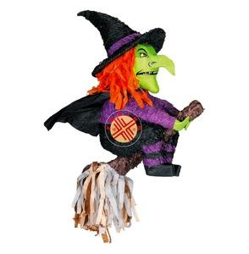
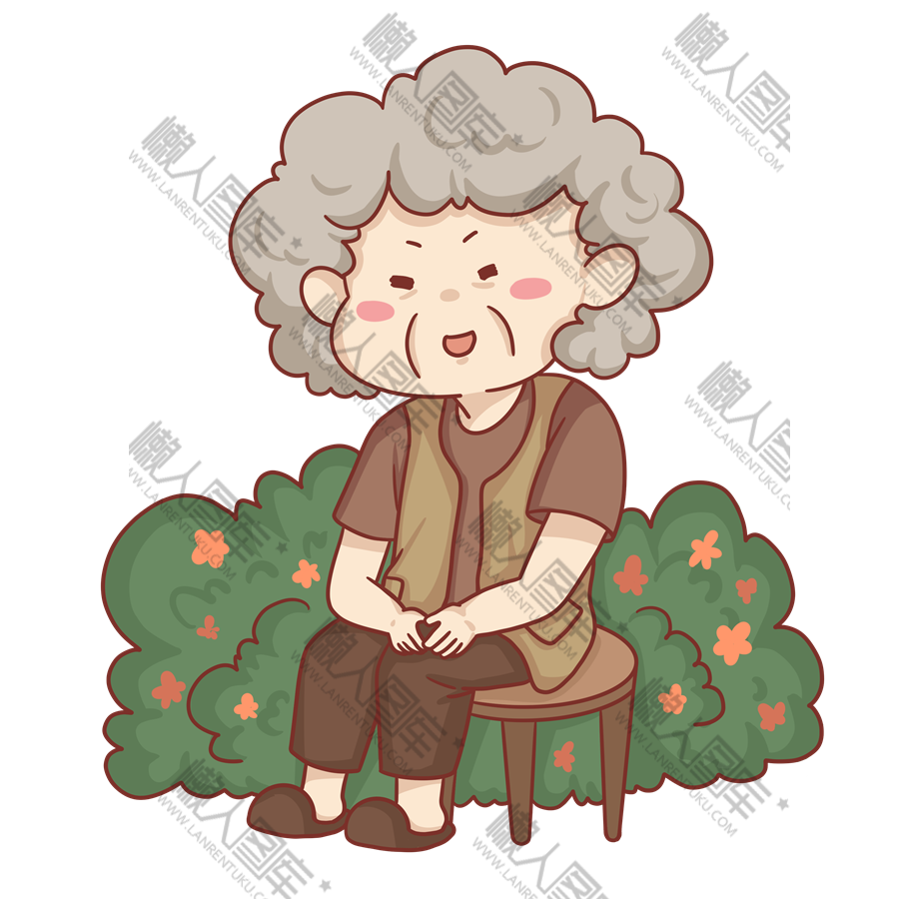
Previous impressions before meeting the CW | Impressions after meeting the CW
weird
considerate
kind-hearted
evil
approachable
She smiled, not a wicked-witch smile, like she was concerned.
The author was told the
decrations up all year
long to attract the
children getting closer
to the house and then
took them.
She hurried into the kitchen and
returned a moment later, handing me
a cup of hot tea.
She sat down across from me, smiling.
+ 语言描写
What can we learn from the author’s experience?

Slide 10
Read for the plot and emotion
I blurted out the next question. “Why?”
Climax
curious
Rising Action
I got into her house and was placed in a chair.
relaxed/
embrassmed
Falling Action
I fell down the stairs and sprained my ankle, unable to walk when delivering papers to her home.
Para1: It was because of my son, Anthony, who died in the war,” said Mrs. Wright.
anxious/
worried/uneasy
I had to deliver papers to her house.
unwilling/upset
Parag2: The doorbell rang and my mother arrived.
What’s the real reason for leaving her Christmas
decorations up all year long?
I knew about her as the Christmas witch.
never to go near her house
frightened/ scared
Ending
Background/Beginning
Story Mountain

Slide 11
Read for structure
Every kid in my neighborhood knew about the Christmas Witch. She was an elderly woman who left her Christmas decorations up all year long: a twinkling tree in the living room, a plastic wreath（花环）on the front door, and...
I was told the decorations were meant to get kids closer to the house so the Christmas Witch could take them. I promised myself I would never go near that place. But when I turned fourteen, I got a newspaper route and discovered I'd have to deliver papers to the Christmas Witch. But my mother just advised me not to worry.
My first day of delivery was a dark, freezing March morning. The sky was just turning pink as I approached the last house on my route… that of the Christmas Witch. I tiptoed up the porch steps and placed the newspaper by the door. Then I quickly turned around. And just then I slipped, and fell down the stairs. I sprained my ankle, unable to walk.
The light was on. The door opened. Someone came out. It was the Christmas Witch.
"Dear me," said she."Are you all right?" Speechless, I pointed at my ankle."Come in; make sure you' re okay." She smiled, not a wicked-witch smile, but a nice smile, like she was concerned. I had no choice. Holding her hand, I got into her house and was placed in a chair."Relax." She hurried into the kitchen and returned a moment later, handing me a cup of hot tea. “I call your parents.” she said.
I told her my mother's number as she dialed. She got through, told my mother everything and turned, “Your mother will be here shortly.” “Thank you, Mrs. Wright.” “You' re welcome.” She sat down across from me, smiling. “You don't have to call me Mrs. Wright; you can call me Christmas Witch.”
I was a bit embarrassed. “It's alright.” She smiled. “I hear what people say. It doesn't matter.” “You do have lots of decorations,” I said. “I think it's pretty，” she replied. I said， “People think it's…weird.” “They don’t understand why I leave up my decorations,” she responded.
Like most teenagers，I just blurted out the next question. “Why？”
1
Para. 1-2 Background information
这两段主要用于将背景信息进行充分介绍，设置了一个圣诞女巫的形象，当然这个形象还只是道听途说并非眼见为实的，因而这个悬念也留待故事的后续解开。
2
3
Before meeting the CW
4
The light was on. The door opened. Someone came out. It was the Christmas Witch.
5
Para. 3-8 The development of the story
读到此处，读者们其实已经明显地感受到莱特夫人形象的巨大反差，坊间流传着的是她古怪的圣诞女巫形象，但现实生活中她却是一个善良热情的老人
6
7
After meeting the CW
8

Slide 12
Paragraph 1: “It was because of my son, Anthony, who died in the war,” said Mrs. Wright.
Paragraph 2: The doorbell rang and my mother arrived.
1.续写的第一段要考虑安东尼的死和她终年将圣诞装饰留在家中到底有怎样的联系。
2.本篇续写和以往不同，因为第二段的首句是母亲到来，两段续写内容上关联不大，在续写第一段的时候主要考虑的就是安东尼战死的版本，这个原因其实有很多，但比较好的设计是“安东尼答应在圣诞节到家，因而老妇人布置一新，结果却等来了儿子战死的噩耗。在巨大的思念之下，老妇人决定保留这一切，以维持儿子在自己内心的回忆”。在叙述这个故事的时候，我们还可以考虑老妇人口述时候的情绪反应，以及我听了这个故事之后有什么反应，也许是感动意外震惊，但更多的也许是惭愧和后悔，因为之前的误解。
3.第二段写母亲到来，首先可以考虑的就是对莱特夫人悉心照顾着儿子的感谢。之后在走出家门后，我将故事告诉了母亲，母亲听了之后又有什么反应。
4.我作为一个14岁的报童，刚开始是小心翼翼地靠近圣诞女巫的家，那么以后还会这样做吗？是不是visit会多一些，company会多一些?需不需要考虑前文提到的other kids?而作者最终要提炼的主题是什么？多一些理解，少一些误解！要注意的是，不管是那一段，主角都应该是老妇人和我，母亲始终是次要角色。

Slide 13
Predict the plot
“It was because of my son, Anthony, who died in the war,” said Mrs. Wright.
Paragraph 1
(How and) when did Anthony die?
How was her son connected with the Christmas decorations?
Afterwards, what was my reaction to it?
Paragraph 2
The doorbell rang and my mother arrived.
What did my mother do/say to Mrs. Wright?
What did I do/say to Mrs. Wright?
What did I learn from the incident?

Slide 14
Design the plot
“It was because of my son, Anthony, who died in the war,” said Mrs. Wright.
Paragraph1
When and how did Anthony die?
1.Anthony was scheduled to come home before Christmas.
2.But three days later after the Christmas Eve, Anthony was killed in a helicopter crash.
How was her son connected with the Christmas decorations?
1. My boy called me on Christmas Eve, promising me to celebrate the Christmas three days later but he never came back.
2. And even though I knew it didn't change anything, I wouldn't take down those decorations, even after all these years.

Slide 15
Design the plot
“It was because of my son, Anthony, who died in the war,” said Mrs. Wright.
Paragraph1
shocked/unexpected
regretful
What did I feel and think?
Mrs Wright wasn't a witch. Instead, she was a sad, isolated mother struggling with the terrible loss of her son.
Paragraph2
The doorbell rang and my mother arrived.
What did my mother do/say to Mrs. Wright?
My mother expressed her heartfelt gratitude to Mrs. Wright and said Goodbye.
Accompanied by my mother, I went home.

Slide 16
Design the plot
The doorbell rang and my mother arrived.
Paragraph2
delighted and relieved
What did I do to Mrs. Wright?
1.Since then, whenever I delieved newspapers to Mrs. Wright, I would share what I think happy things happening with her. She would always smile, saying
how much she enjoyed my visit.
2.I shared the story with other kids. Since then, the kids would...
3.I didn't think of her as the Christmas Witch anymore. Instead, I regarded her as a kind-hearted woman like my mom.
What did I learn from the incident?
Returning home, I promised that I would never judge a person before I knew the truth.
Be a little less judgmental and a bit more
understanding toward others.
主题升华
少一点评判，多一点理解他人

Slide 17
After all these years, that experience has always helped me remember that ageless lesson: Be a little less judgmental and a bit more understanding toward others.
Outside her house, the sky was clear and the wind was brisk. There was no Cristmas witch but a beloved mother as well as a happy old woman.
The pink light shed by the up-rising sun painted that house rosey, in which never lived a wicked witch but a gentle old lady who was beloved by all of us.

Slide 18

参考范文
“It was because of my son, Anthon, who died in the war,” said Mrs. Wright. “Anthony was scheduled to come home before Christmas. He called me on New Year's Eve, teling me to leave up the Christmas decorations. But three days later, Anthony was killed in a helicopter crash. My boy never made it back home. And even though I know it doesn't change anything, I won't take down those decorations, even after all these years.” Mrs. Wright wasn't a witch. She was a sad, isolated mother struggling with a terrible loss.
The doorbell rang and my mother arrived. Accompanied by my mother, I went home. My sprained ankle healed quickly. Since then, whenever I delivered newspapers to Mrs. Wright, she smiled, saying how much she enjoyed my visit. Funny, I didn't think of her as the Christmas Witch anymore. Several years later, Mrs. Wright had passed away. After all these years, that experience has always helped me remember that ageless lesson: Be a little less judgmental and a bit more understanding toward others.

